Slide 1
Social Psychology
Attitudes
“A learned predisposition to think, feel and behave toward a person (or object) in a particular way.”
Allport (1954)
“A person’s evaluation of any psychological object.”
Azjen & Fishbein (1980)
psychlotron.org.uk

Slide 2
Attitudes Defined:
An attitude is an individual predisposition to evaluate an object in a (un)favourable way
Objects can be of many different kinds:
• things e.g. products, people
• organisations e.g. companies, political parties
• activities e.g. driving, recycling
• ideas e.g. communism, religions
An attitude is a learned tendency to respond to people, objects, or institutions in a positive or negative way. Attitudes are made up of three components. This is known as the tripartite model.

Slide 3
Structure of attitudes – ‘tripartite model’
Cognition (thinking)
Behaviour (action)
Affect (emotion)
attitude
psychlotron.org.uk
Based on Allport (1954)

Slide 4
Attitude Structure – ‘tripartite model’
Attitudes have 3 components:
    Affective – emotional reactions towards attitude object (how we feel) Feelings towards the object of an attitude
    Cognitive – thoughts and beliefs about attitude object (how we think). What a person believes about the object of an attitude
    Behavioral – actions towards attitude object (how we act). One’s actions towards various people, objects, or institutions

Slide 5
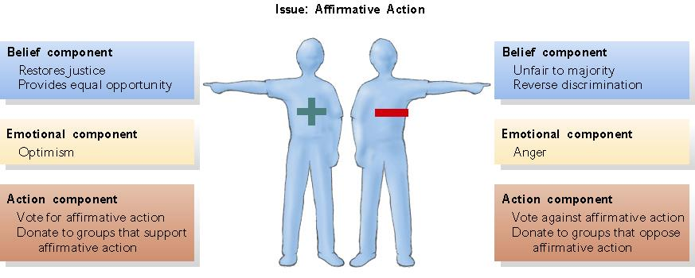
Fig. 19.1 Elements of positive and negative attitudes toward affirmative action.

Slide 6
Attitude Formation
Attitudes are formed from:
Direct Contact: Personal experience with the object of the attitude
Interaction with Others: Influence of discussions with people holding a particular attitude
Child Rearing: Effects of parental values, beliefs, and practices
Group Membership: Social influences from belonging to certain groups
Mass Media: All media that reach large audiences (magazines, television)
Mean Worldview: Viewing the world and other people as dangerous and threatening

Slide 7
Function of attitudes – what are attitudes for?
Attitudes mediate between inner needs and the outside world.
Katz (1960) identified four functions of attitudes:
  Adaptive
  Knowledge
  Value-expressive
  Ego-defensive
psychlotron.org.uk

Slide 8
1) Adaptive Function
Help people achieve goals, avoid bad things e.g.
  Gain membership of a social group (as in normative conformity)
  Obtain approval from others (e.g. a parent)
2) Knowledge Function
Attitudes help structure & organise our understanding of people & the world e.g.
  Directing info processing towards important data
  Simplifying complex objects & situations
psychlotron.org.uk

Slide 9
3) Value-expressive function
They help us express ourselves and communicate with others e.g.
  Political & other value-based attitudes
  Membership-based attitudes
  Attitudes that emphasise non-membership & distinctiveness
4) Ego-Defensive Function
Help to protect us from psychological harm e.g.
  Help us feel good about ourselves
  Provide protective ‘explanations’ for negative events (e.g. prejudice)
psychlotron.org.uk

Slide 10
Attitude Change – can we change people’s attitudes?
Governments, businesses and others attempt this but with limited success.
Potential means for attitude change (we must change the function of the attitude):
• instrumental – provide information on consequences of behaviour
• ego defensive – appeal to insecurities
• value expressive – play to existing beliefs
• knowledge – attempt to build a network of associated attitudes.
The ability to change attitudes depends on both characteristics of individuals and objects. Attitudes change spontaneously – usually due to social influence.This is an important link between the individual and the social context.

Slide 11
Changing attitudes - Persuasion
Persuasion: Deliberate attempt to change attitudes or beliefs with information and arguments
  Communicator: Person presenting arguments or information
  Message: Content of communicator’s arguments
  Audience: Person or group to whom a persuasive message is directed
Changing attitudes - Brainwashing
Brainwashing: Engineered or forced attitude change requiring a captive audience
Generally three steps to brainwash someone:
  Unfreezing: Loosening of former values and convictions
  Change: When the brainwashed person abandons former beliefs
  Refreezing: Rewarding and solidifying new attitudes and beliefs

Slide 12
Question:
When might it be more useful to focus on the structure of attitudes & when might it be better to focus on their function?
psychlotron.org.uk

